Slide 1
Pokémon RPI
Theodore Tenedorio, Tommy Fang, Aman Zargarpur

Slide 2


Overview
Fundamentally based on the 2nd generation Pokémon engine.
Adapted maps and storyline for the RPI campus and culture.
Improved game mechanics and playability.

Slide 3
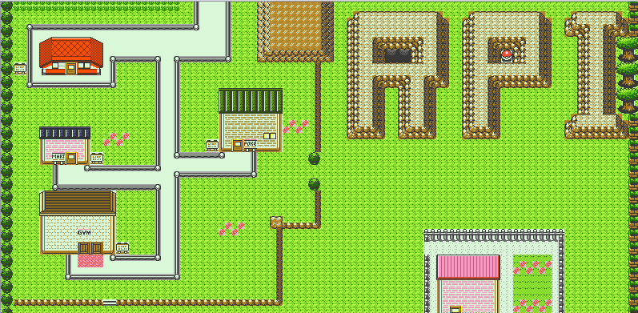
Current State
Game Engine v0.5
Demo at end of presentation!!
Supports custom maps.
Integrates map data, image libraries, and animation resources.

Slide 4
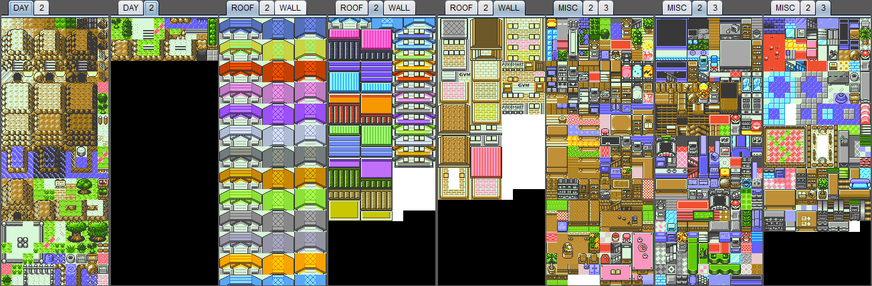
Current State Cont.
Image Library v0.9
A working repository of every tile, sprite, and image resource to be used by the game.
Currently only missing sprites for attack animations.

Slide 5
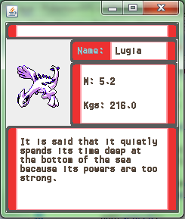
Current State Cont.
Pokédex v0.7
Dynamically stores and displays data on Pokémon.
Does what you expect.

Slide 6
Current State Cont.
Battle Engine v0.1
Complex and dependent on a large number of peripheral systems.
Animation Engine v1.0
A working generic animator, that can handle multiple ongoing animations quickly and efficiently.
Backpack v0.8
Sorts, indexes, and stores the hundreds of in game items.

Slide 7
Future Plans
Entire map of campus
Content will be released as fast as we can produce it.
Starting zone to be completed by the end of the semester
More Pokémon! More moves! More items!
Original storyline featuring RPI.
Start over as a freshman and immerse yourself in a similar, but new world.
This will also provide invaluable hints on how to survive at RPI.
Rebalancing stats and certain mechanics pertaining to battle system.
Pick your own residence hall!
As residence halls become implemented, players will be able to where they want to live.

Slide 8
Future PLANS CONT.
Dialogue and cut scenes.
Original Pokémon music/sound.
Improved player experience.
Create meaningful play through discernible goals and outcomes.
New Game Plus
A new game mode after you have beaten the main storyline is available for players who want more of a challenge.
Rare Pokémon will appear more frequently.
Secret new mechanics will be added to increase challenge.

Slide 9
Future Plans CONT.
Level design
Implement puzzles to engage players.
Ensure quality gameplay that is goal-oriented.
Provide an immersive experience that makes players want to explore the campus.
Multiplayer
Battle with and against friends!
Possible ladder/ranking system.

Slide 10
Acknowledgements
Prof. Moorthy
Sean O’Sullivan
Prof. Goldschmidt
RCOS

